Slide 1
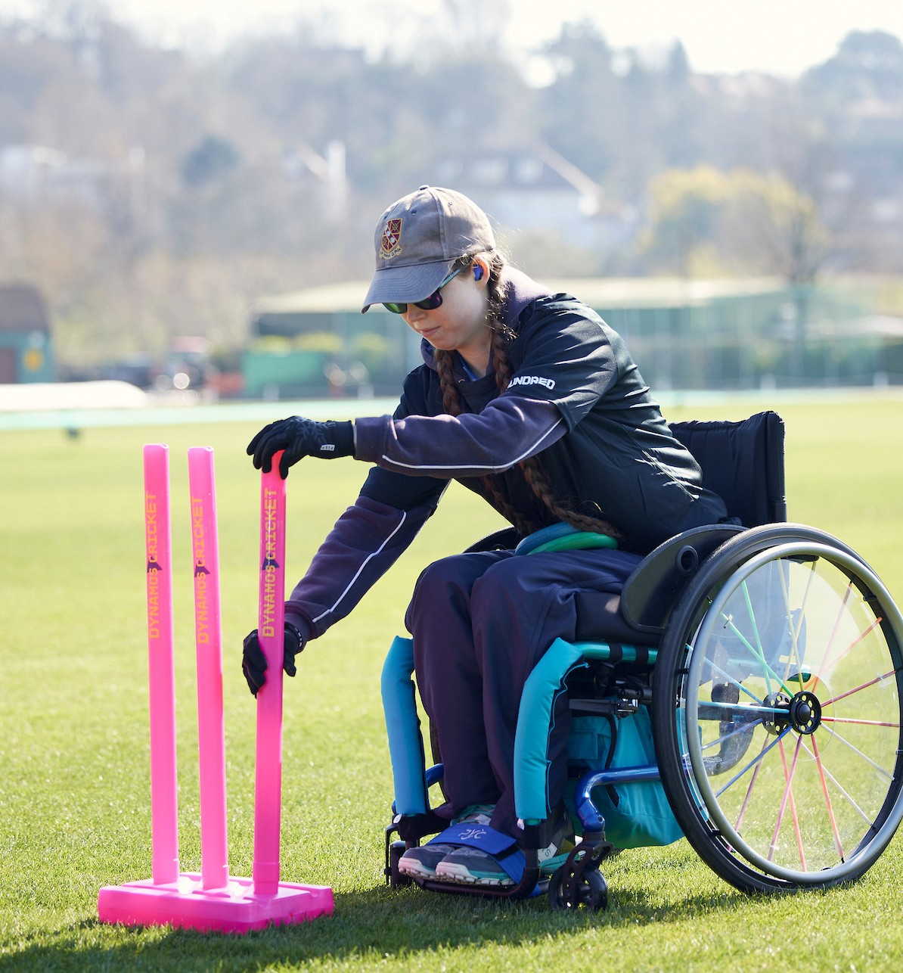
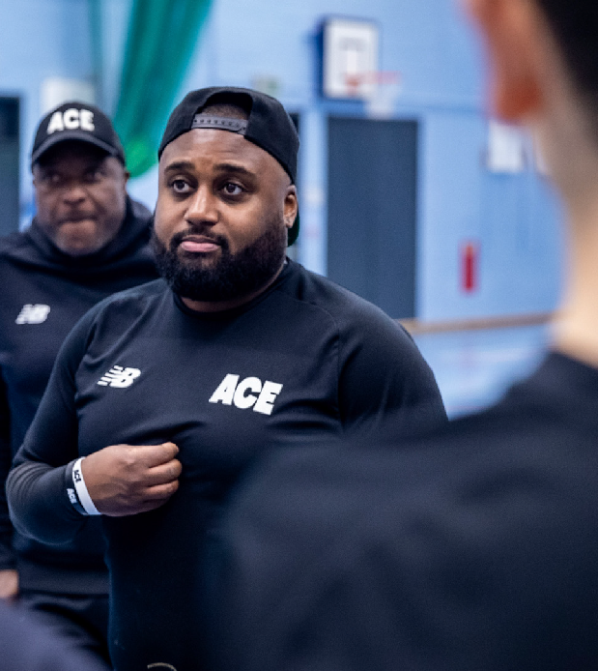
TOOLKIT: Creating a Club for Everyone
Use this toolkit to assess how your club can start Raising the Game
Audience: Cricket club committees
Purpose: to support discussions and actions within your cricket club that can help create an inclusive environment and help you create a Club for Everyone.
What’s included: This toolkit is in three parts to help have focused conversations that start with the basics. Clubs are encouraged to progress through each part at their own pace.
How to use:
Individually read and reflect on the questions provided
Schedule meetings to discuss the questions as a group, focusing on one of the three parts each time
Through the discussions develop actions / next steps and assign owners
Update the club’s EDI action plan and communicate plans with the club members
Hold each other to account for actioning on the plan by reviewing the questions on a regular basis
Tip: If you aren’t able to answer a question without making an assumption, seek out someone who can help you understand the answer. We want to avoid making assumptions at all times, and ensure all voices are heard and represented.
Part 1: Tackling Discrimination
Part 2: Welcoming & Inclusive Club
Part 3: Diverse & Inclusive Leadership

Slide 2
A big thank you to
Derbyshire Cricket Foundation
for Raising the Game by providing
the original concept for this toolkit

Slide 3
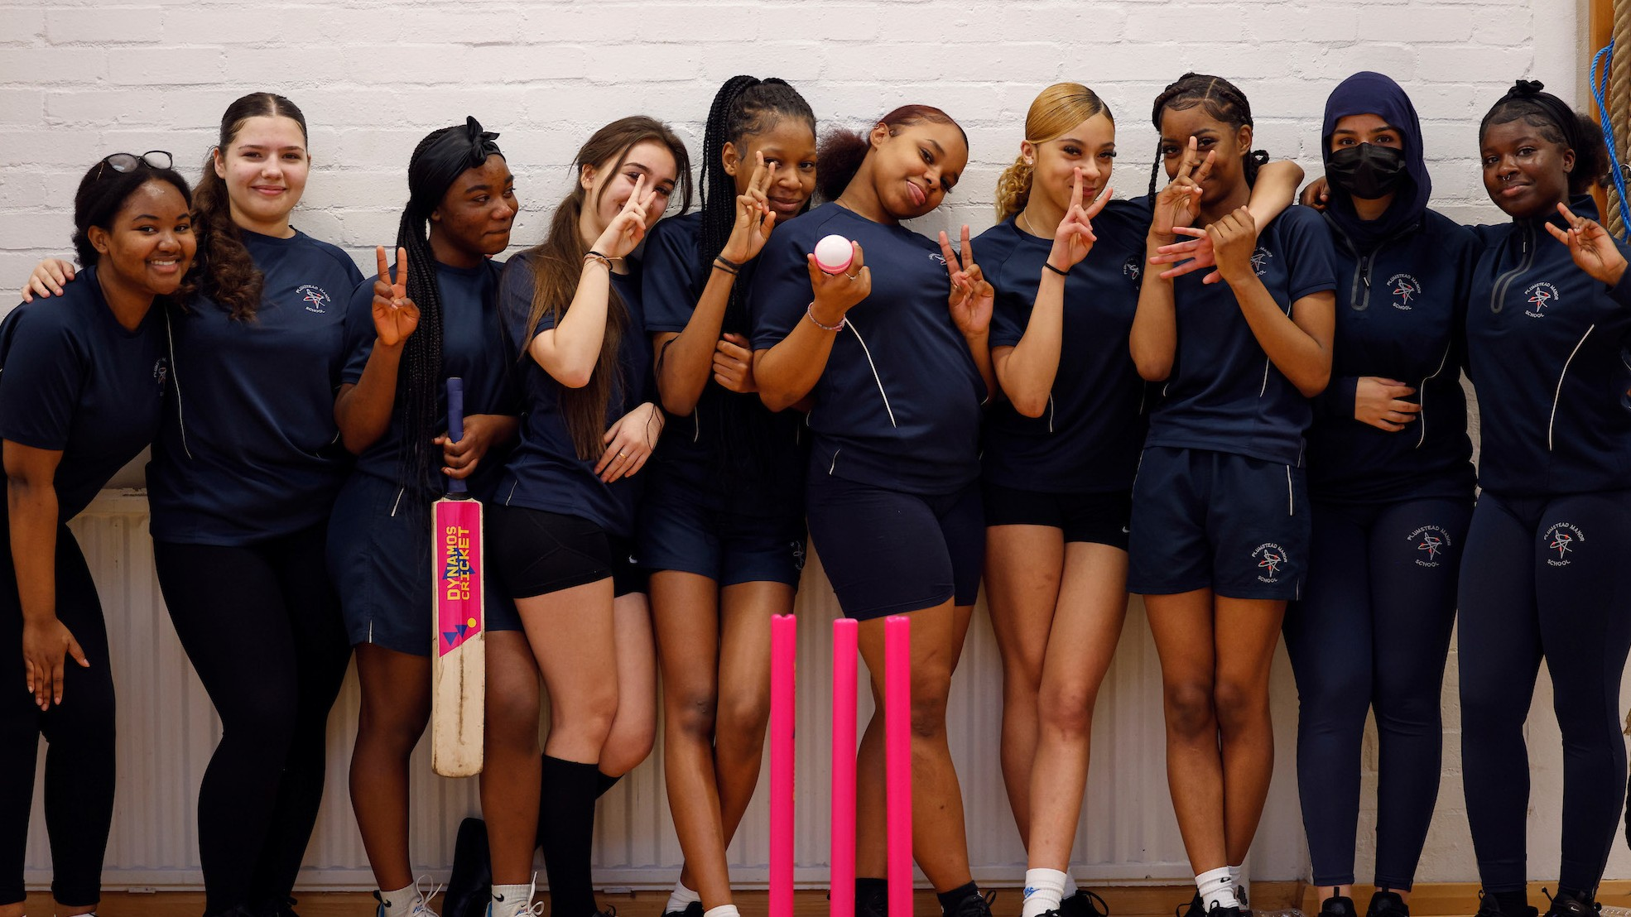
Part 1: Tackling Discrimination

Slide 4
Insert Club / County logo here
TOOLKIT: Tackling Discrimination
“Would our members recognise discrimination and know what to do if they experienced or observed it?”
Things to consider | What improvements do we need to make? | What are our next steps? | Who is going to own this?
Have we adopted the ECB anti-discrimination code? Have we communicated the code and our expectations to members? Have we got a process for reporting issues within the club? Are members aware of it? Would they be confident using it? Have we communicated the ECB discrimination reporting process?
“Would officials and volunteers at our club know what to do if they observed discrimination / if it was reported to them?”
Things to consider | What improvements do we need to make? | What are our next steps? | Who is going to own this?
Have key officials within the club completed anti-discrimination training? Would they be comfortable addressing discriminatory behaviour if they observed it? Have we seen examples of this? Have we clarified their roles and responsibilities in the event that somebody raises an issue with them? Are people equipped to challenge discriminatory behaviour/banter? Have we run training on ‘how to have difficult conversations’? Would the administrators of our social media channels (including group chat applications like WhatsApp) recognise it and know what to do if banter crossed the line into discrimination?

Slide 5
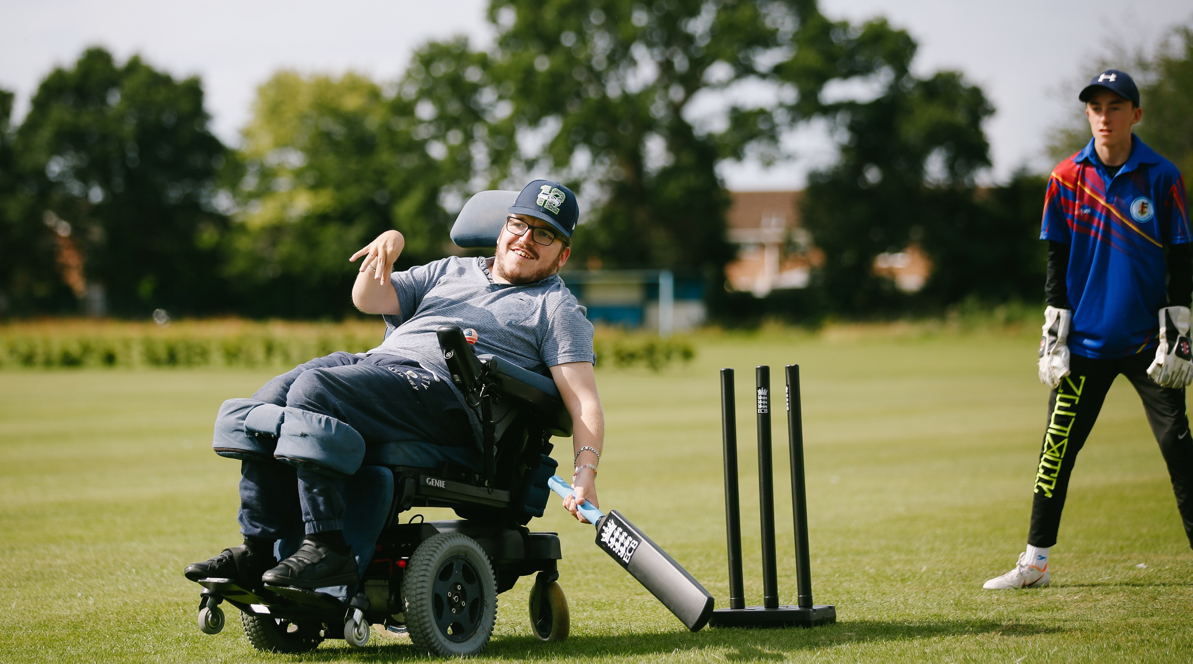
Part 2: Welcoming & Inclusive Club

Slide 6
Insert Club / County logo here
TOOLKIT: Welcoming and Inclusive Club
“Have we taken steps to make our facilities accessible and welcoming to everyone?”
Things to consider | What improvements do we need to make? | What are our next steps? | Who is going to own this?
Have we consulted the ECB guidance on “Creating Welcoming Environments”? Have we completed the ECB facilities survey? Have we taken any practical steps to make our club facilities more accessible and inclusive? (e.g. to females, young/older people, those with an impairment or disability) Have we considered becoming a Disability Cricket Champion Club to support disabled people to get involved at your club? |  | Have we applied to the County Grants Scheme to fund improvements to our facilities?
“How welcoming is our club to various ethnicities and religions?
Things to consider | What improvements do we need to make? | What are our next steps? | Who is going to own this?
Is there an understanding and respect for different customs related to different religious beliefs? (i.e. relating to diet, alcohol, modesty) Do we consider these customs related to different religious beliefs when we organise events? Do we recognise that different religious festivals may impact on the availability to play of our members or those of opposing clubs? Are our junior members respectful when playing against teams with ethnic representation different to them?

Slide 7
Insert Club / County logo here
TOOLKIT: Welcoming and Inclusive Club
“Do our female members receive equal opportunity and feel fully integrated into our club?”
Things to consider | What improvements do we need to make? | What are our next steps? | Who is going to own this?
Do female members feel like they have a voice in the running of the club? Do they have voting rights & adequate representation on the committee? Do female members have equal access to facilities, and coaching/training/playing opportunities? Do boys and girls get equal opportunity to play and practice? What steps has the club taken to create a better environment for female members? Are the language/symbols around the club male-centric?
“Have we created welcoming and safe spaces for the LGBTQ+ community?”
Things to consider | What improvements do we need to make? | What are our next steps? | Who is going to own this?
Do our policies explicitly reference LGBTQ+ inclusion? Do we show visual signs to promote a safe space for the LGBTQ+ community? Do we promote allyship and participate in LGBTQ+ campaigns? (e.g. participating in rainbow laces) Do we offer training/guidance on the acceptable use of language? Do we encourage the use of pronouns? Do we have alternative changing facilities for those who may wish to change in private?

Slide 8
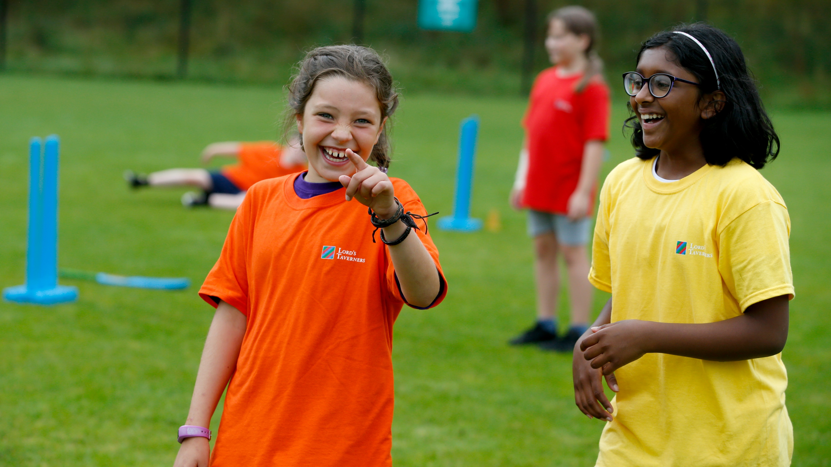
Part 3: Diverse & Inclusive Leadership

Slide 9
Insert Club / County logo here
TOOLKIT: Diverse & Inclusive Leadership
“Do we have diverse representation on our committee and involved in the management of our club?”
Things to consider | What improvements do we need to make? | What are our next steps? | Who is going to own this?
Do we have members with a diverse range of experience involved in managing our club? Would people without a background in cricket feel valued and included on our committee? Do we have a range of different age-groups represented on our committee? Do our volunteers reflect the diversity within our membership and our community?
Do we have mechanisms that ensure we monitor our progress and continue to be an inclusive and welcoming club?
Things to consider | What improvements do we need to make? | What are our next steps? | Who is going to own this?
Do we gather feedback from our members on how welcoming and inclusive they feel our club is? Is this something that we discuss as part of our Committee or Club Strategy development process? Is there a role on our Committee that leads on having a “welcoming and inclusive club”?

